Slide 1
HOW TO MAKE YOUR GHS ACCOUNT PAYMENT
( Online – Instant Pay option)

Slide 2
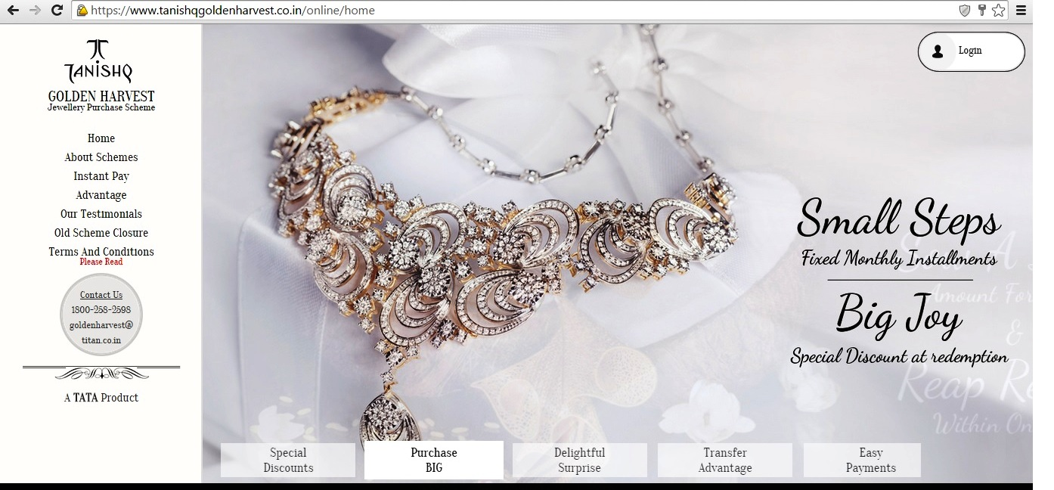
https://www.tanishqgoldenharvest.co.in/

Slide 3
Plz choose Instant Pay option

Slide 4
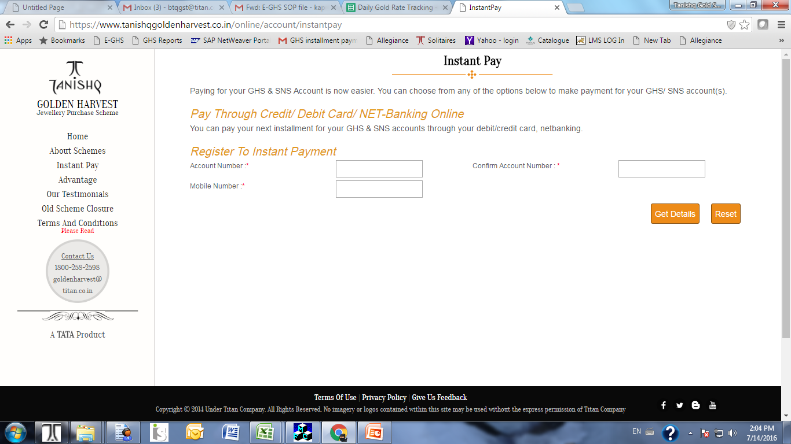
Plz enter required details (mandatory fields)

Slide 5
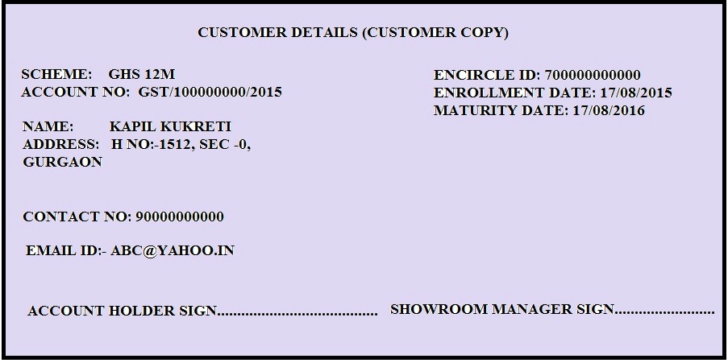
Kindly refer your GHS passbook to fill required fields

Slide 6
Important Points
While entering Account number, only numeric part need be enterred. For Example( if account no is GST/100000000/2015, only 100000000 need to be enter).
Contact number should be exactly same as printed on your pass book.

Slide 7
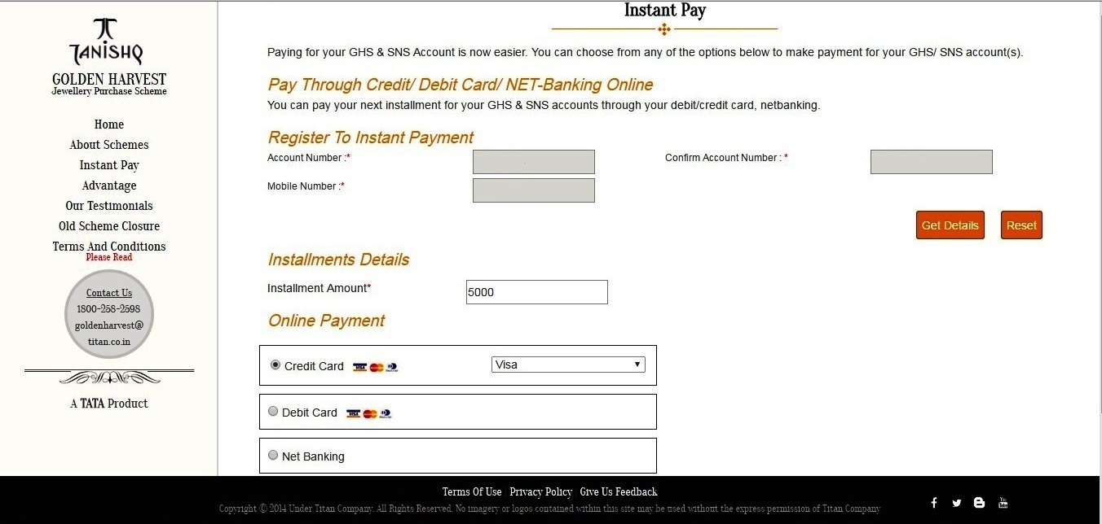
After Entering the details in required fields click on get details

Slide 8
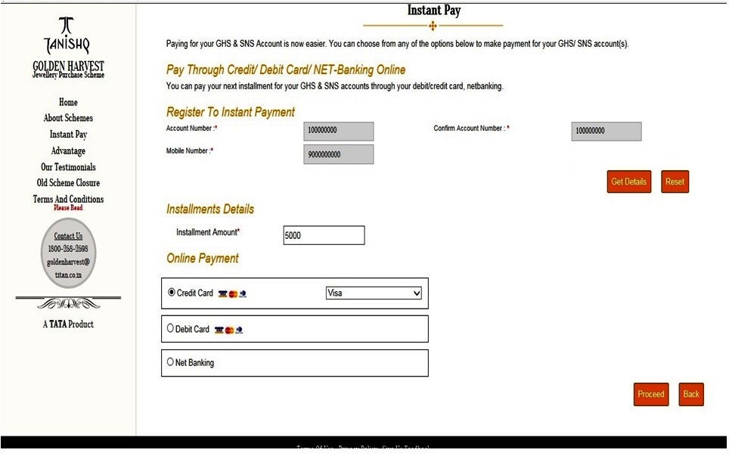
Now choose mode of payment

Slide 9
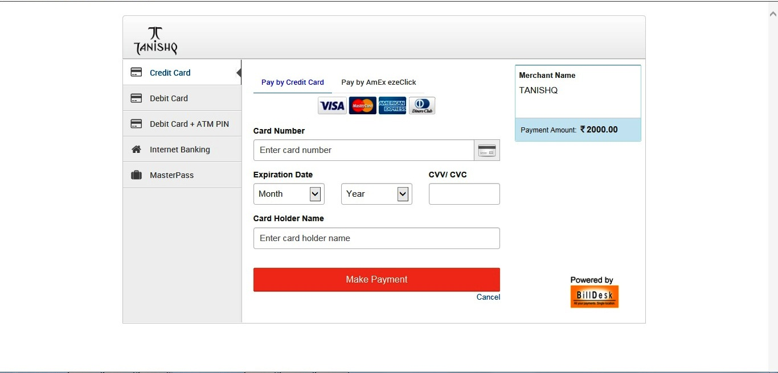
After entering the details click on make payment.

Slide 10
KINDLY CONTACT FOR ANY ENQUIRY
goldenharvest@titan.co.in
18002582598

